Slide 1
PORTO
CALYPSO South Final Meeting
22nd October 2021
Audrey Zammit

Slide 2
PORTO
PORTO

Slide 3
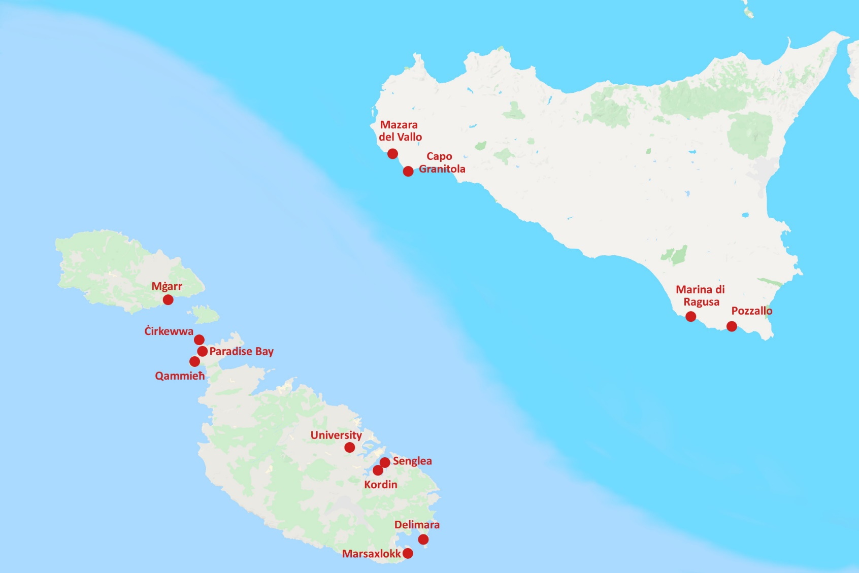
PORTO – Stations network
Includes both meteo stations and sea level stations
Stations cover main harbours and marinas

Slide 4
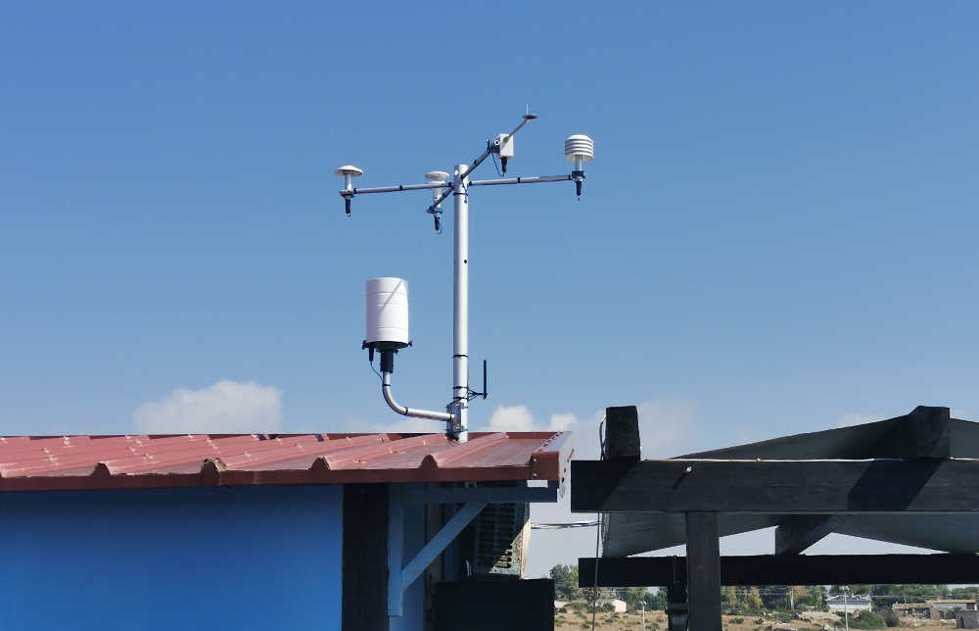
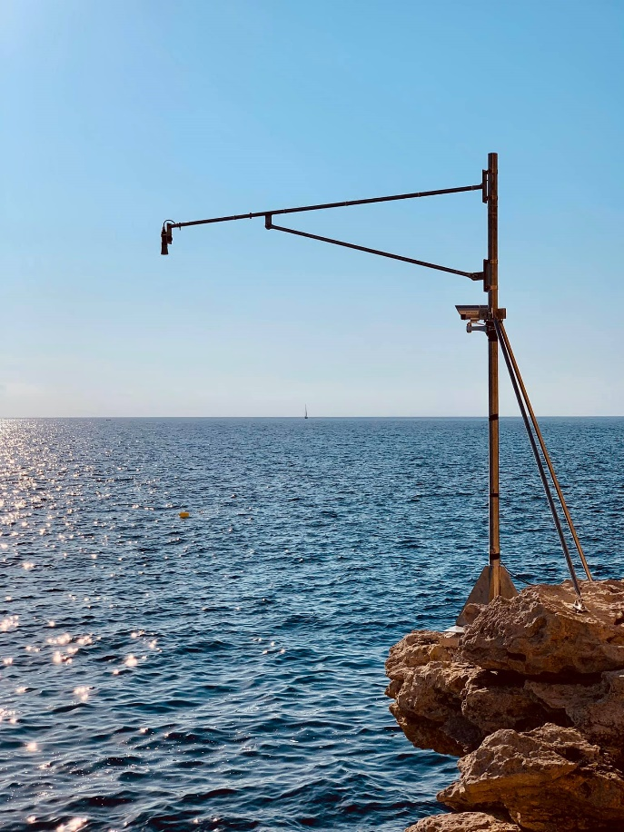
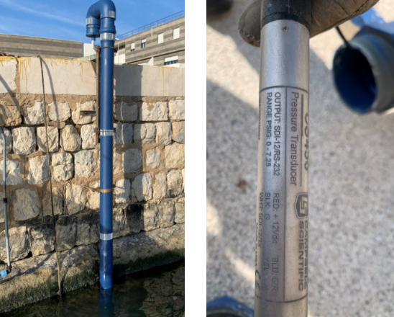
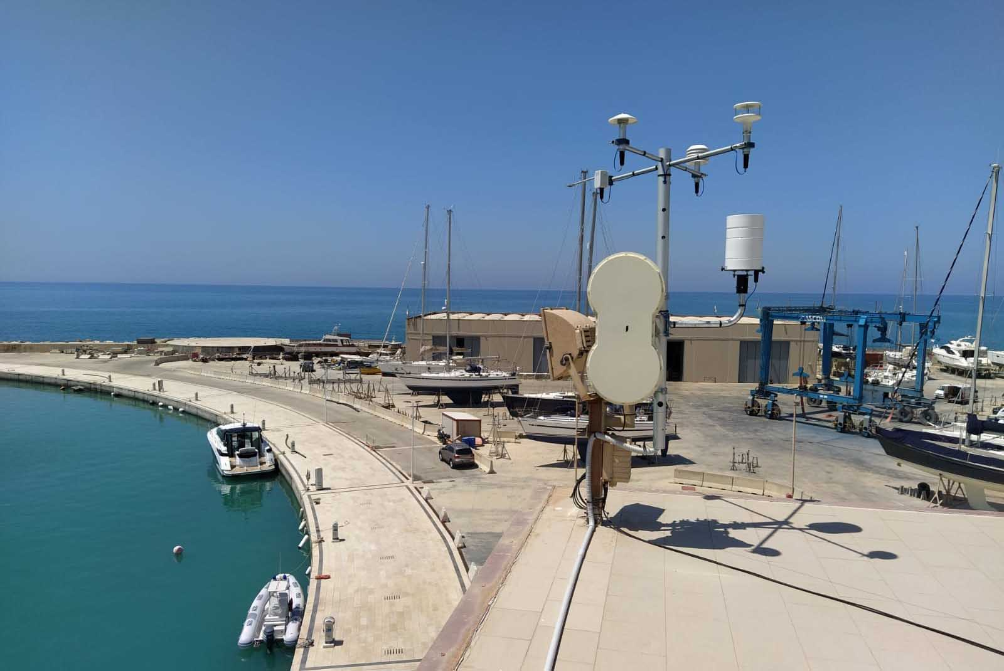
PORTO – Stations network

Slide 5
PORTO – Stations network
Sicily | Malta
Mazara del Vallo | Mġarr, Gozo
Capo Granitola | Ċirkewwa
Marina di Ragusa | Qammieħ
Pozzallo | Grand Harbour
 | Delimara
 | Marsaxlokk

Slide 6
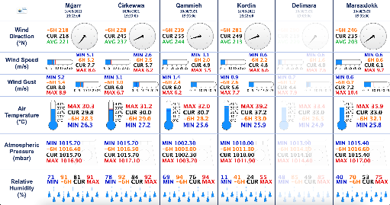
PORTO – Data

Slide 7
PORTO – Data
Stations measure data every minute
Data is transmitted to server as a text file using FTP
Script writes data to MySQL database every minute
Interfaces read data from database every 15 seconds

Slide 8
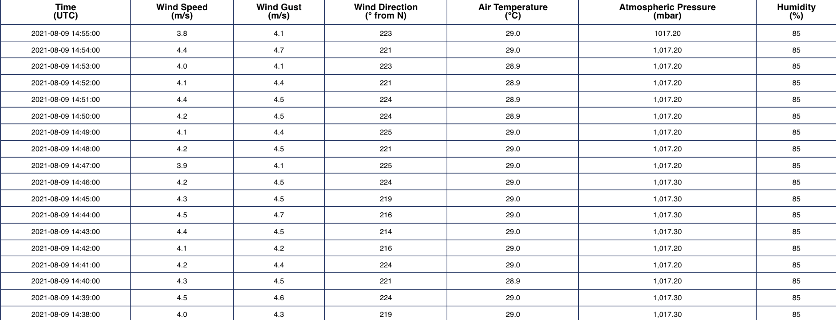
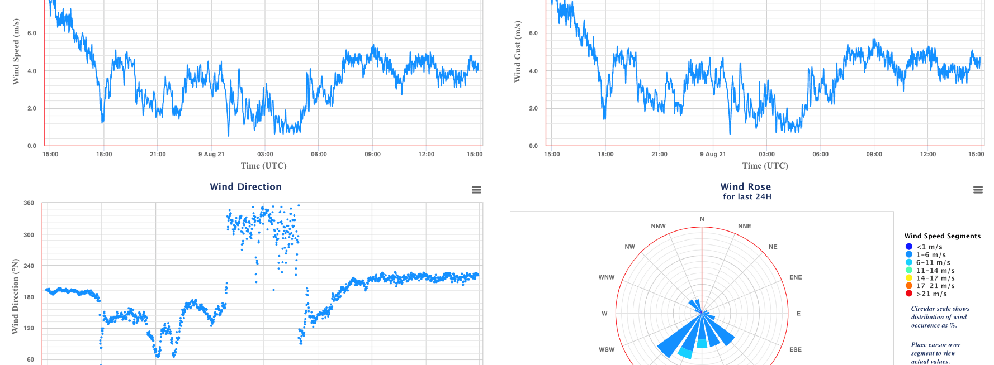
PORTO Stations Interface

Slide 9
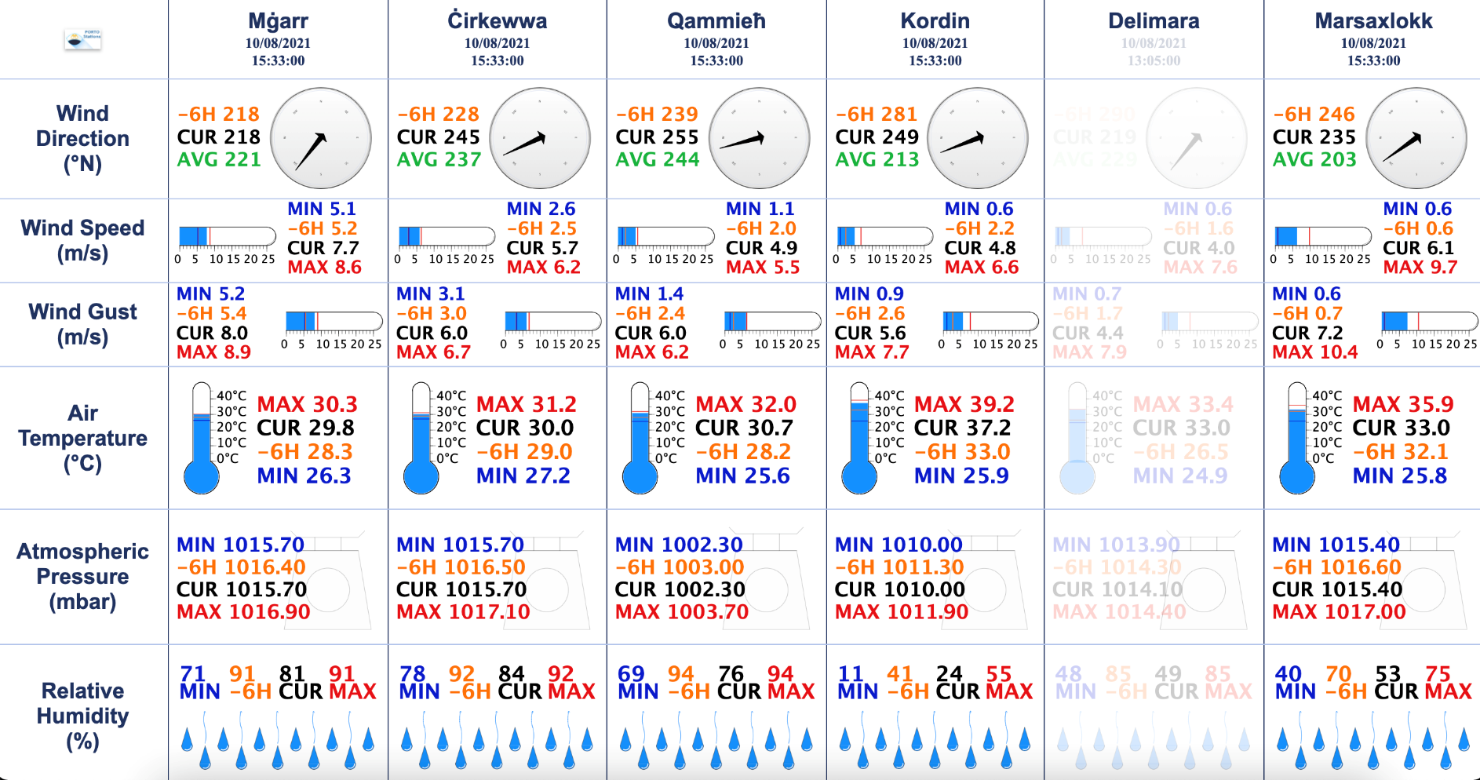
PORTO Dashboard
Provides a snapshot of the current meteo conditions around the Maltese Islands

Slide 10
PORTO Online
Models
Remote sensing
Coastal observations
Data sources

Slide 11
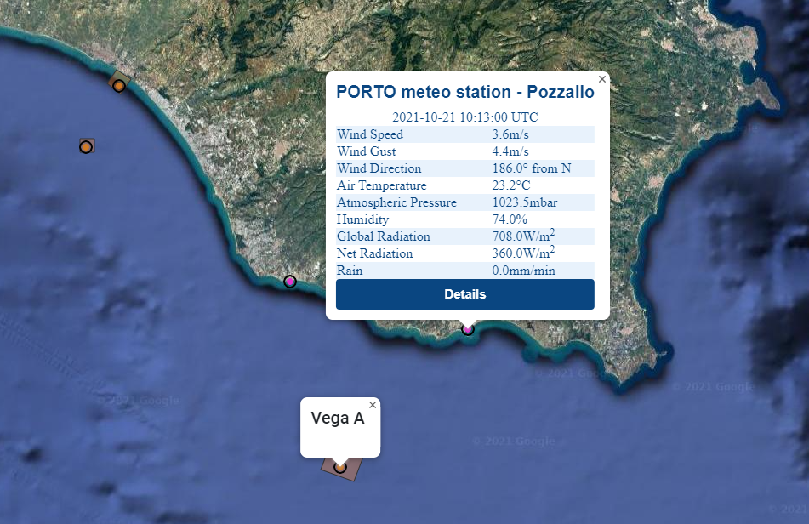
PORTO Online - features
Data is shown
in location
on map

Slide 12
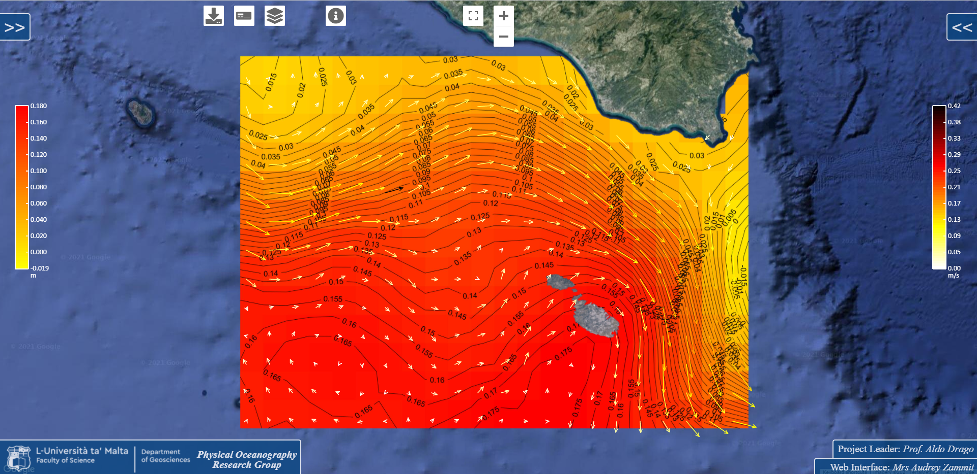
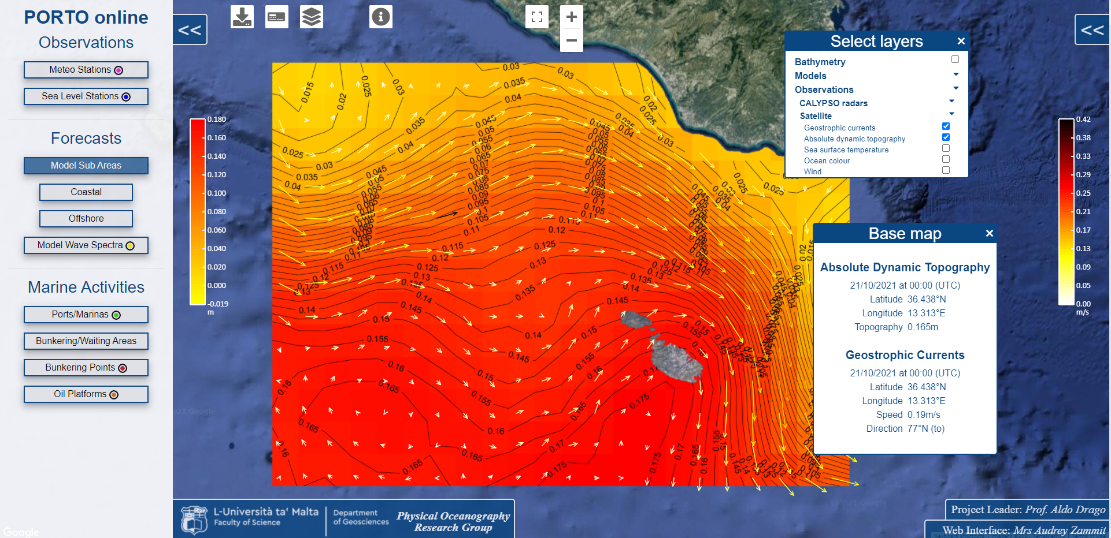
PORTO Online - features

Slide 13
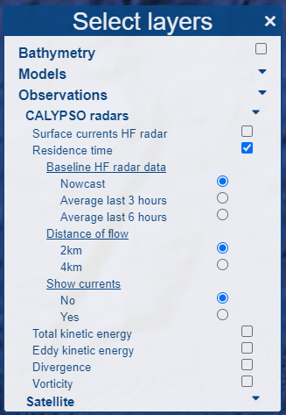
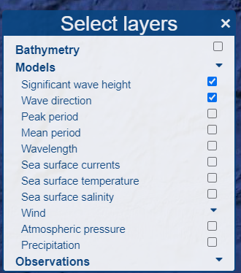
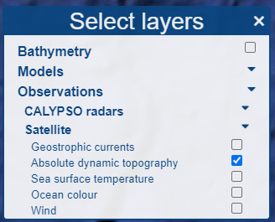
PORTO Online - features

Slide 14
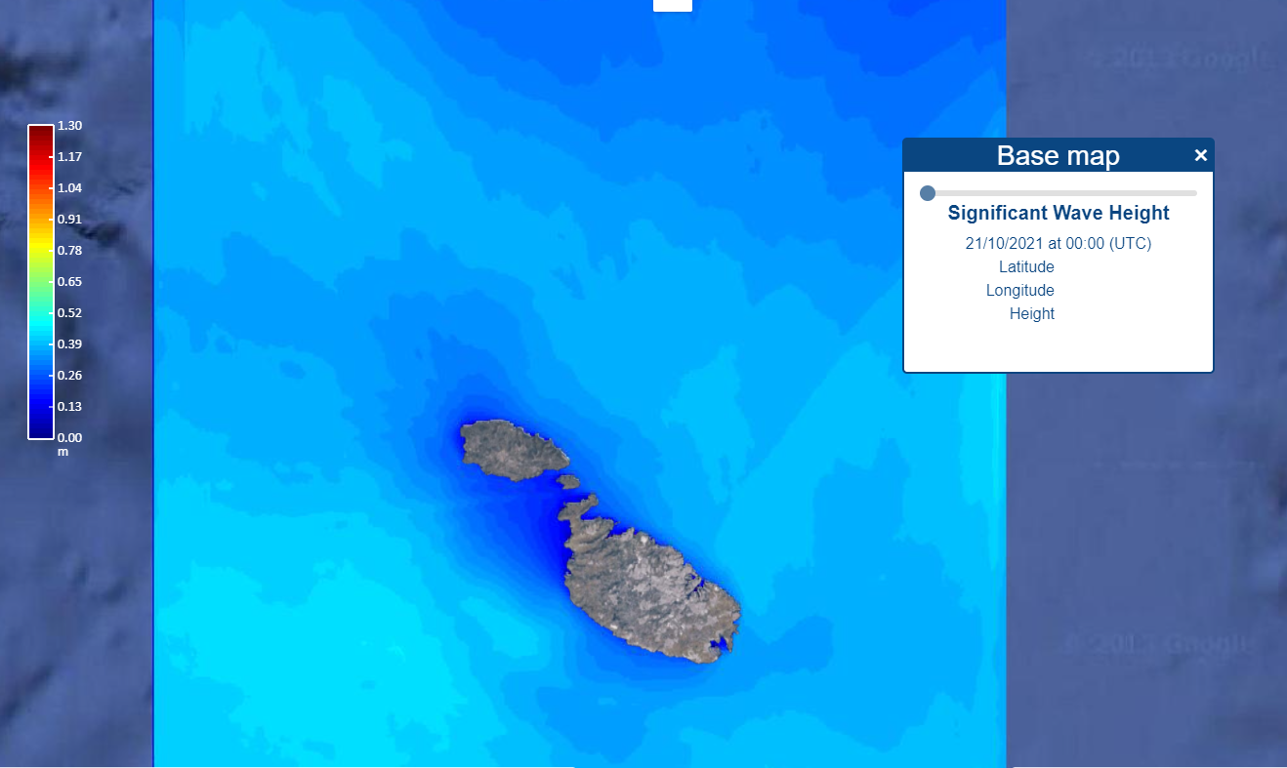
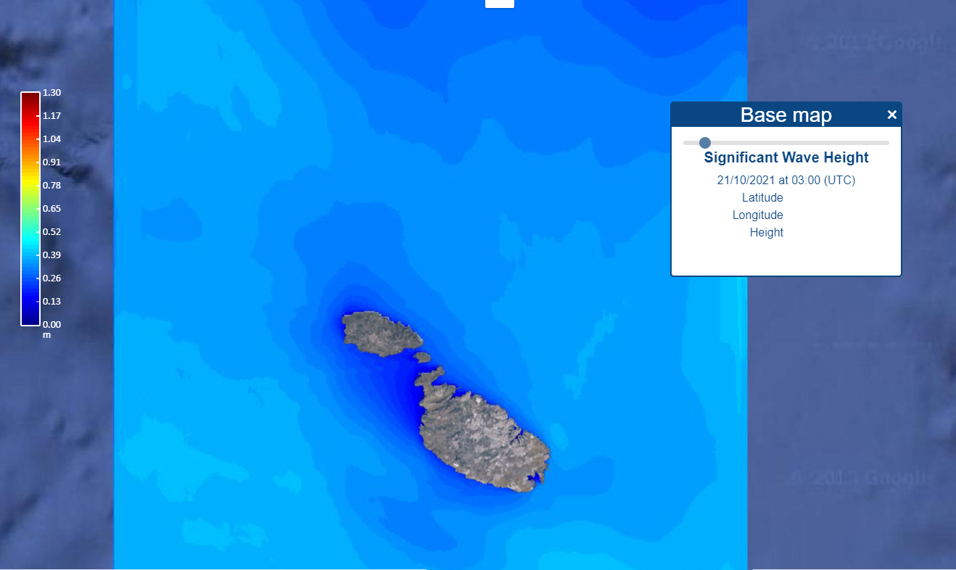
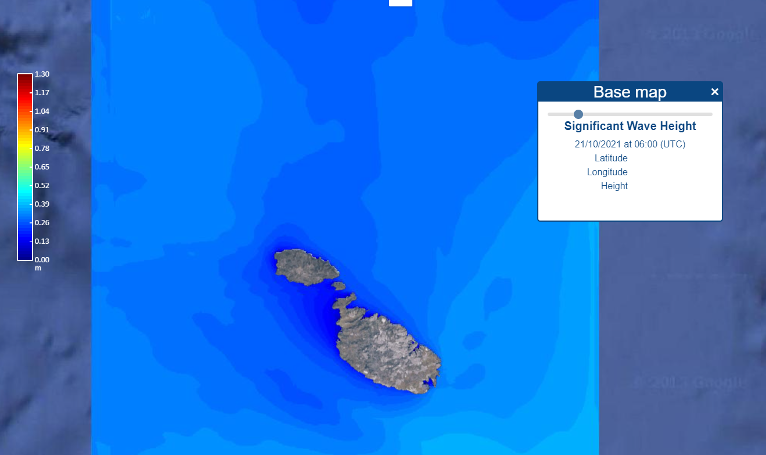
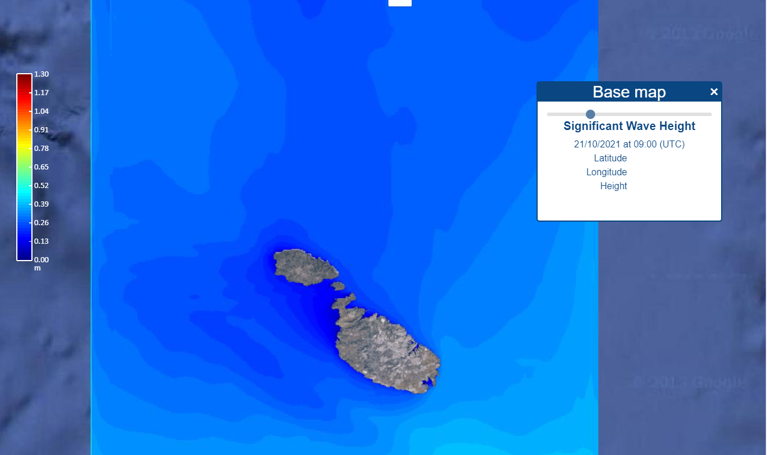
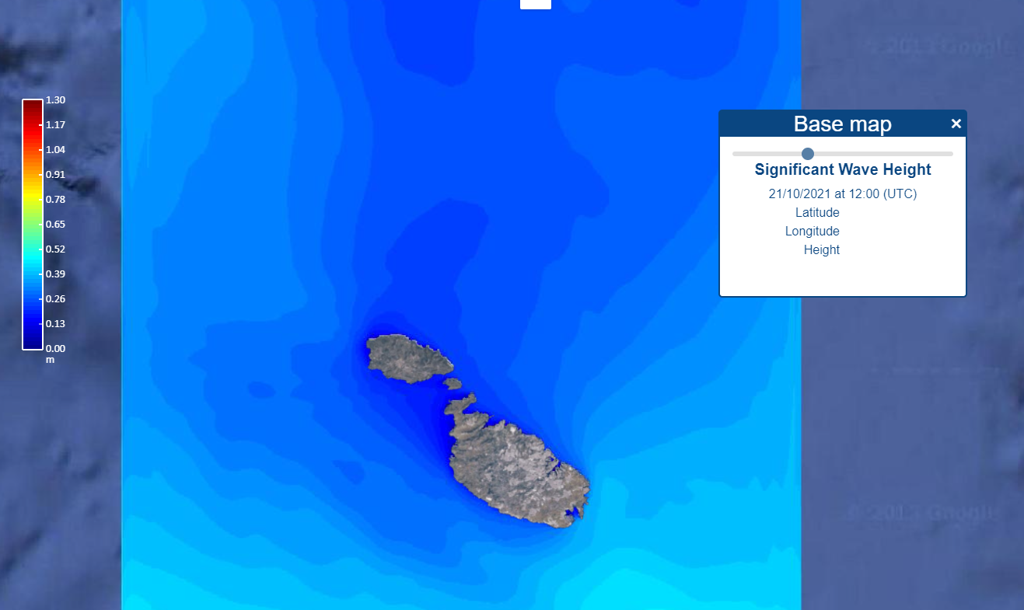
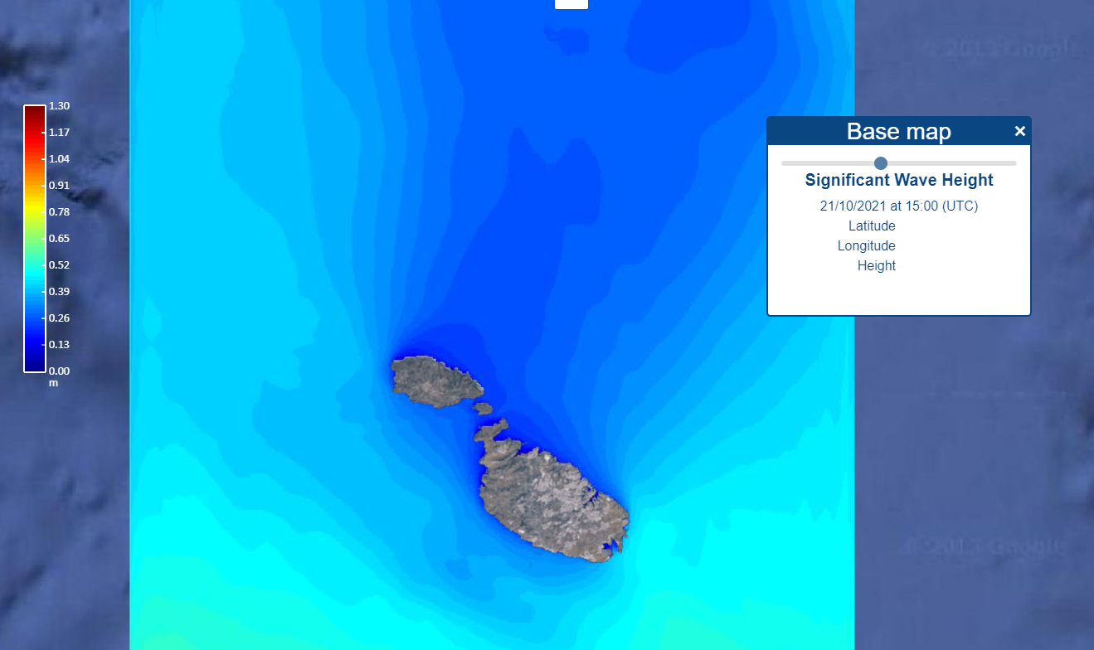
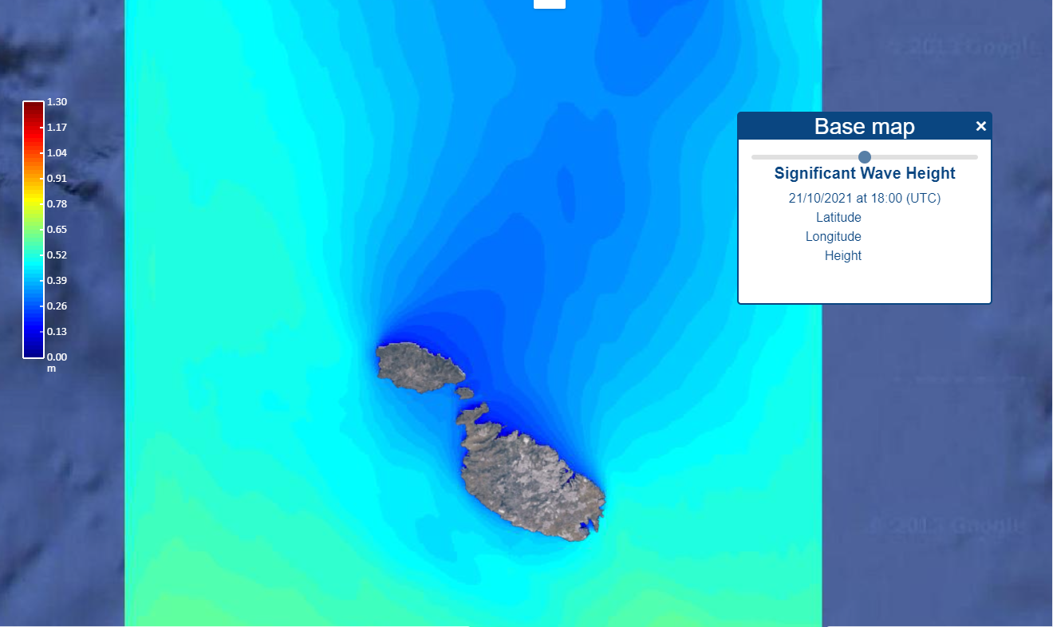
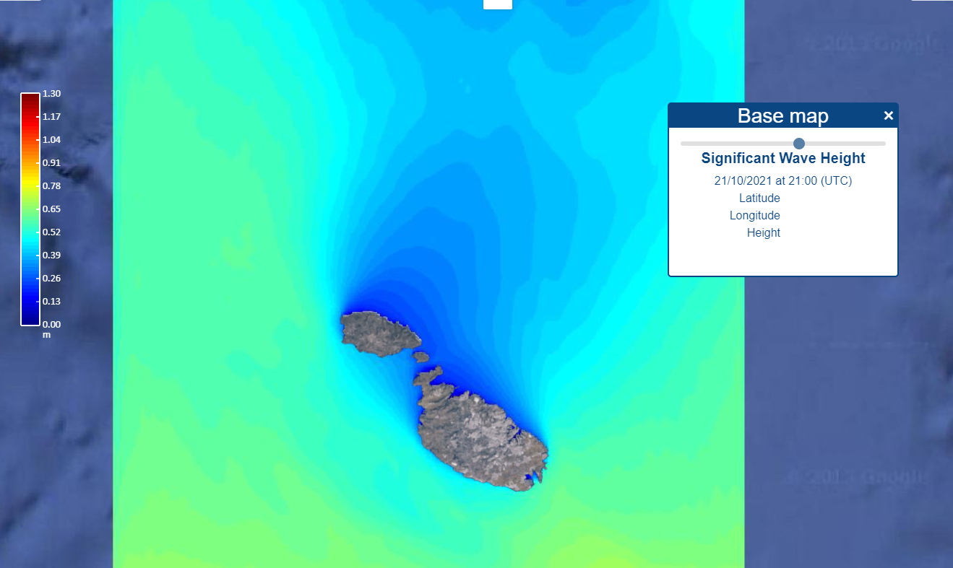
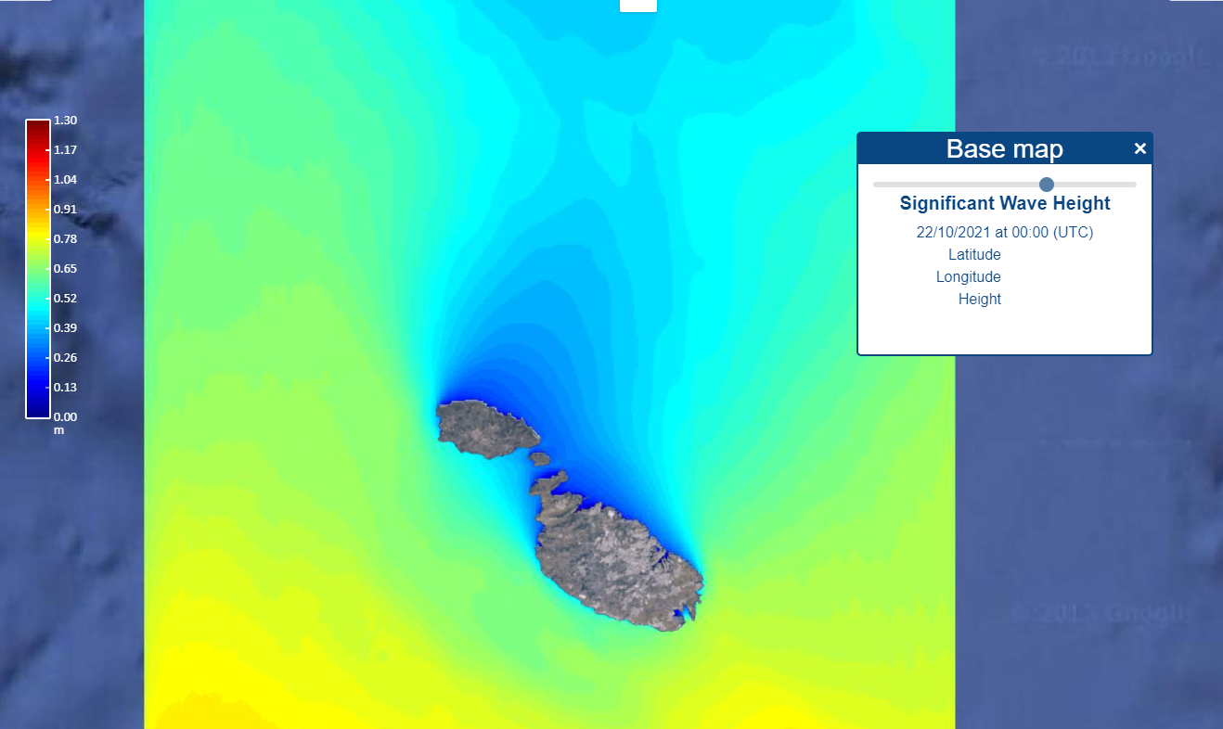
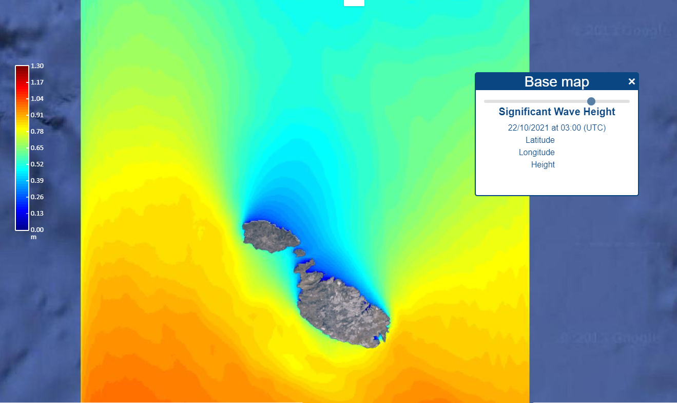
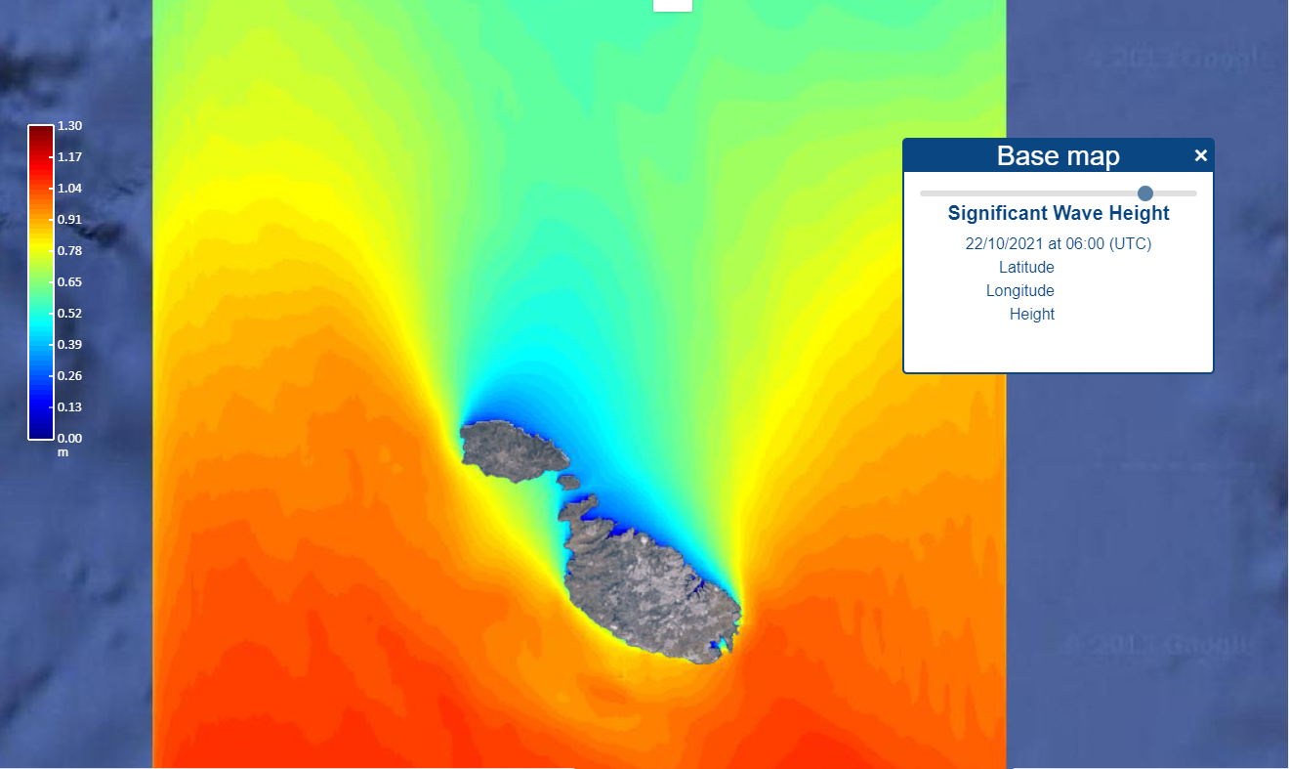
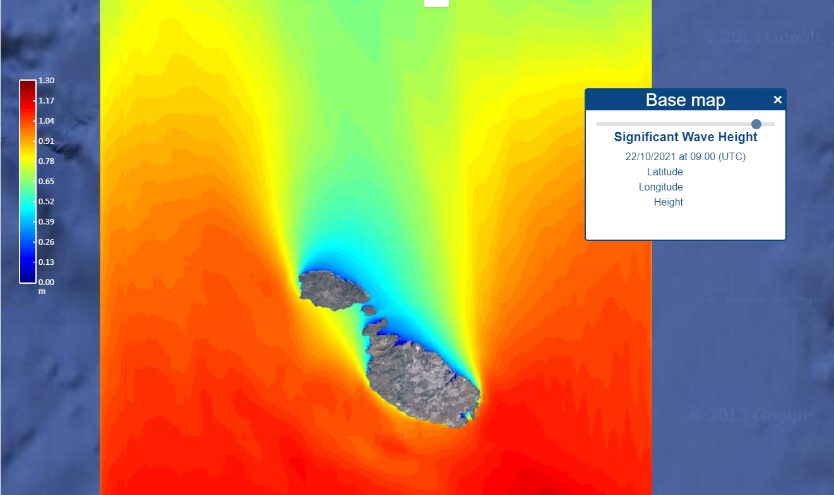
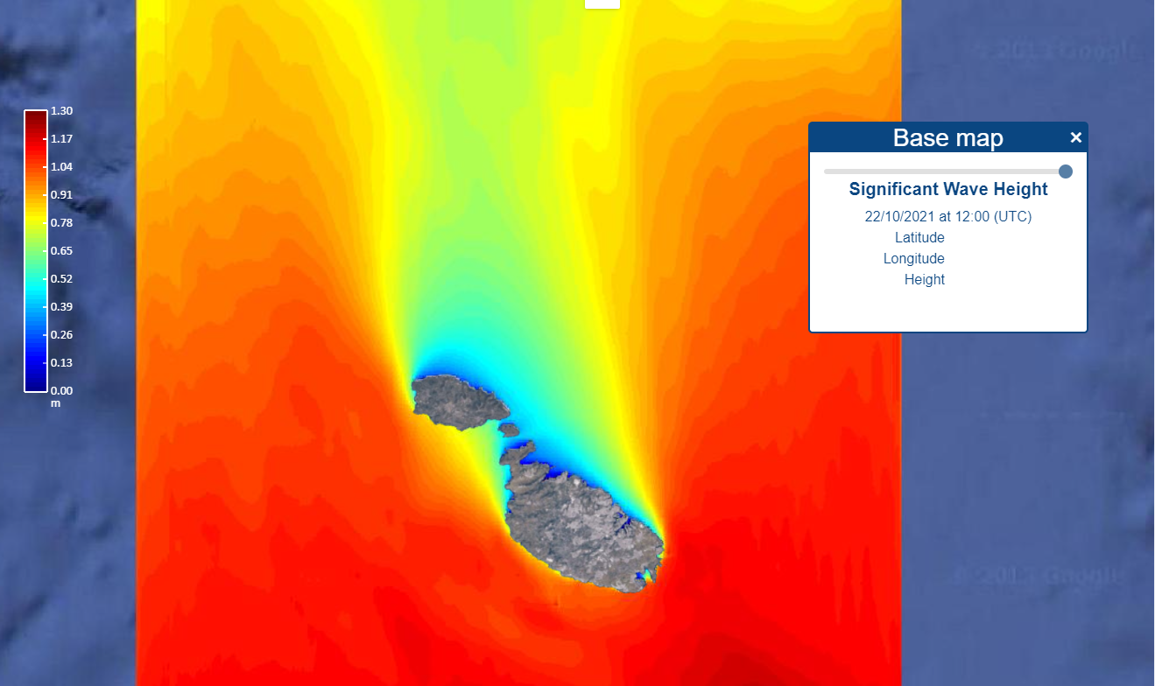
PORTO Online - features
Time slider

Slide 15
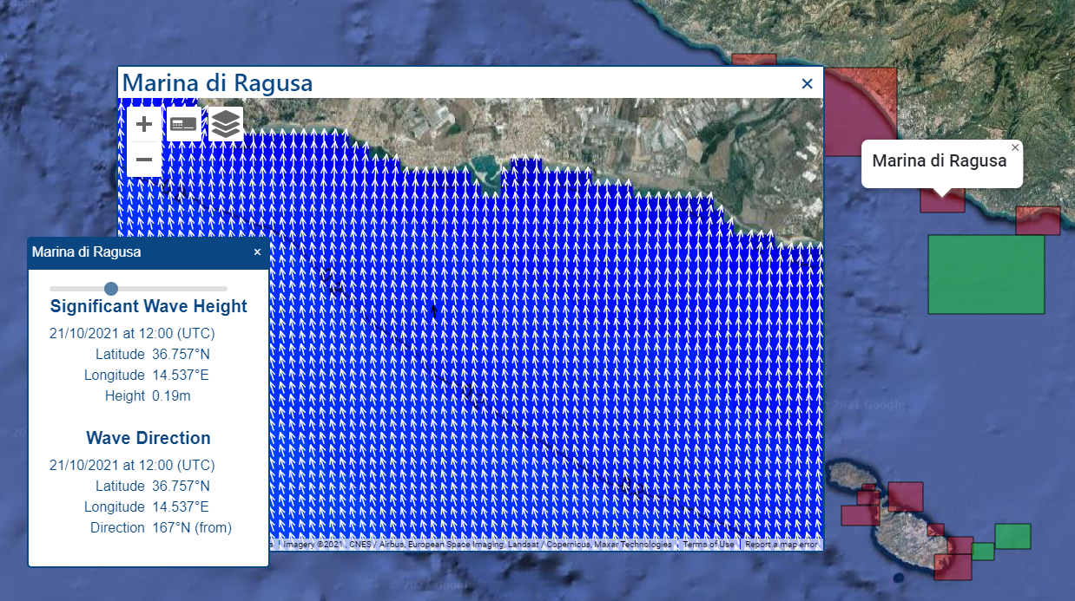
PORTO Online - features
Model
sub areas

Slide 16
Grazie
Thank you
Grazzi

